Slide 1
EXPENSE TRACKER
BL.EN.U4CSE19091 Kavya Reddy
BL.EN.U4CSE19110 PREETHI REDDY
BL.EN.U4CSE19140 SHRAVYA VATTIKUTI
BL.EN.U4CSE19154 SRAVYA REDDY

Slide 2
ABSTRACT
In today’s fast pacing life, we often forget to manage our finances. This often leads to bigger problems on the long run. To curb this, we have decided to design an Expense tracker which as the name suggests allows us to track our daily expenses and intimates us when we are over boarding our savings. The user can define their expenses in different categories. Our application also shows you an analysis of your spending in a particular time frame. This can help the user better understand his/her transaction patterns.

Slide 3
Modules used
Login
Register
Forget password
Profile management
Expense management
Settings management
Show analysis

Slide 4
Languages used:
Front end: Python, Tkinter
Backend: MySQL

Slide 5
Requirements:
Hardware: laptop(i5), RAM(8GB)
Software: MySQL Workbench, Python IDLE 3.10.1

Slide 6
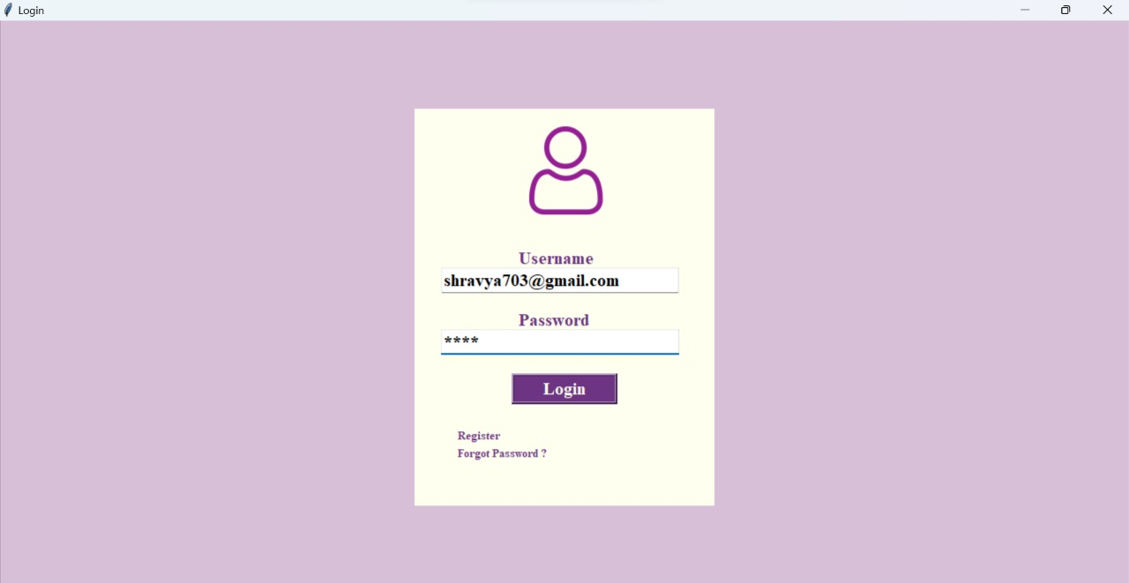
LOGIN

Slide 7
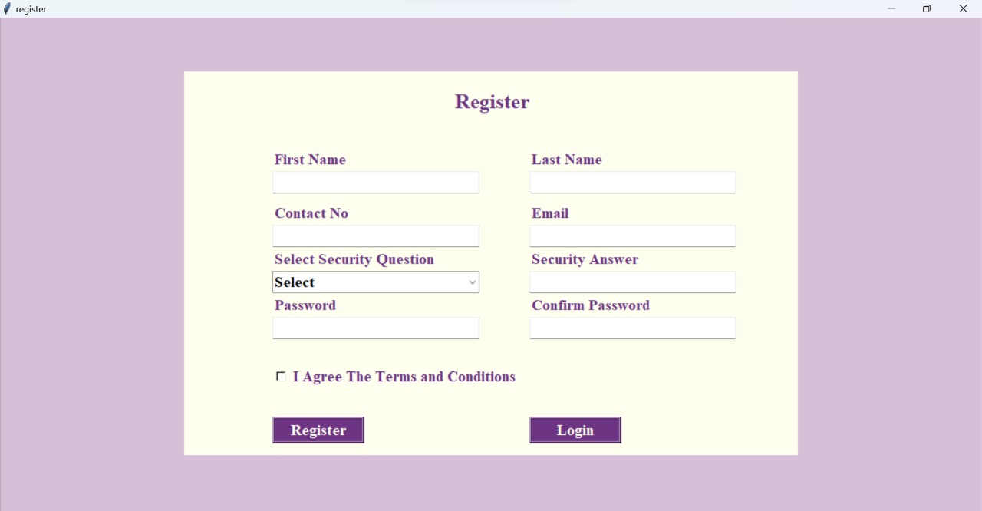
REGISTER

Slide 8
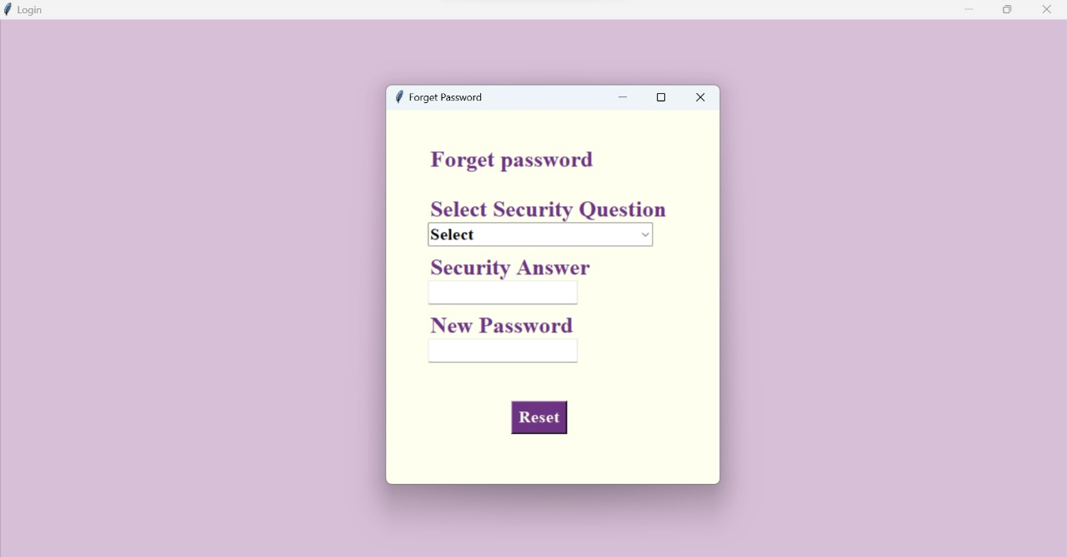
FORGET PASSWORD

Slide 9
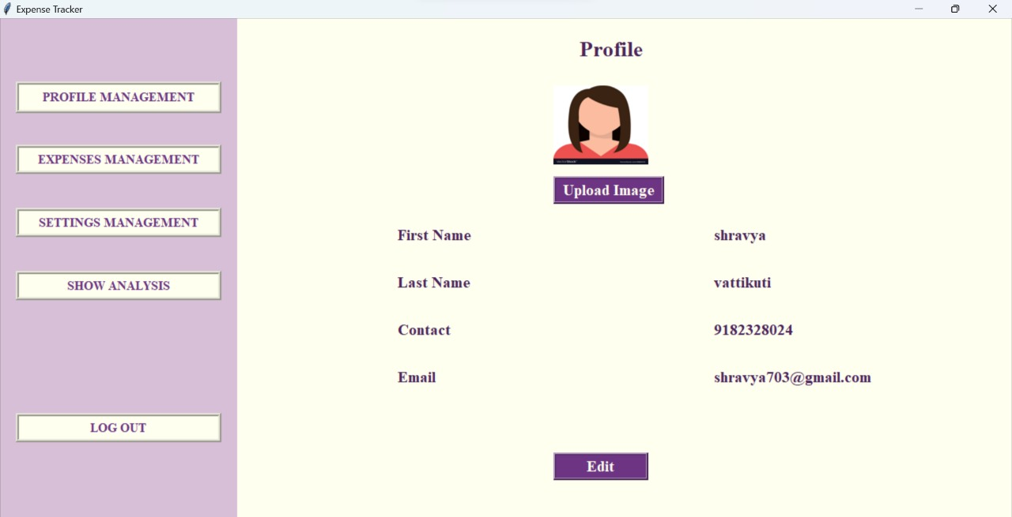
PROFILE MANAGEMENT

Slide 10
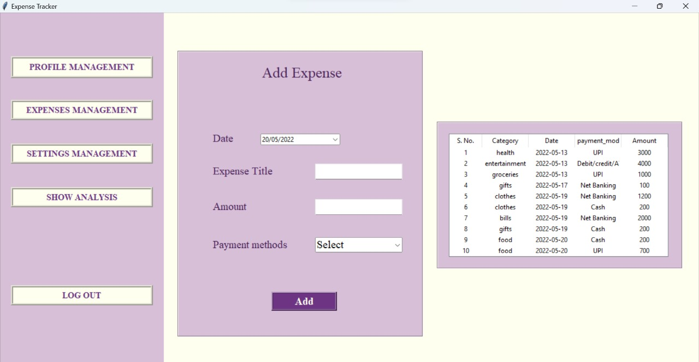
EXPENSE MANAGEMENT

Slide 11
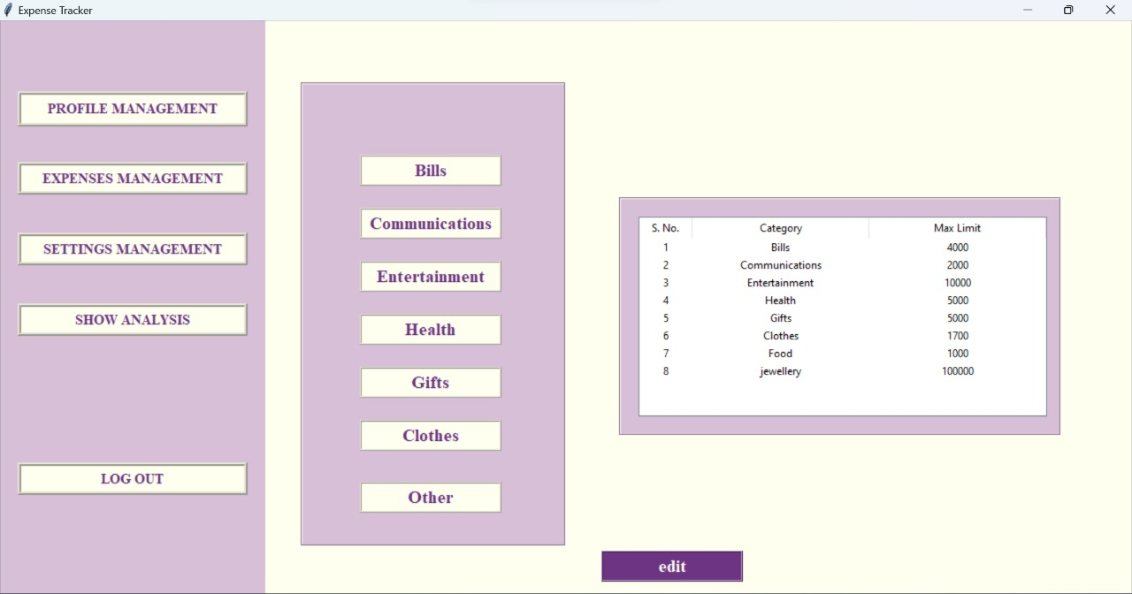
SETTINGS MANAGEMENT

Slide 12
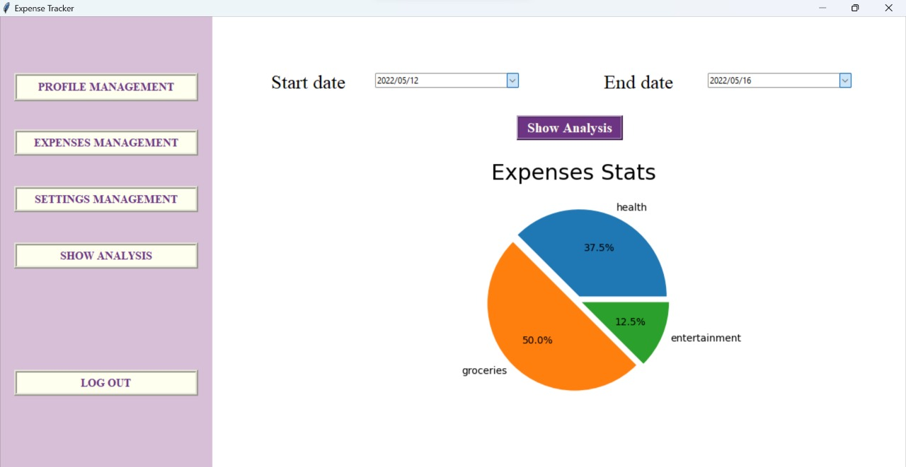
SHOW ANALYSIS

Slide 13
THANK YOU

